Slide 1
BRRRRRT ISA
By Ryan Ramirez and Sovreign-Ariel McCarthy

Slide 2
The Plan
The initial plan was to implement as many functions as we needed in order to
produce a user friendly coding language
Create a sense of familiarity (without redundancy)
Make an ISA in which we can utilize each skill learned throughout the semester
Find out if we can surpass our own expectations

Slide 3
Original Functions
Multiplication – Takes the number stored in register 0 and multiplies it to a number input by a user. The new number gets stored back into register 0
Division – Takes the number stored in register 0 and divides it by a number input by a user. The new number gets stored back into register 0
Brrrrrt_Modulus – Takes the number stored in register 0 and divides it by a number input by a user. The remainder of the new number gets stored back into register 0
Brrrrrt_Round – Takes in a number, input by a user, and rounds it up or down to its respective proximity

Slide 4
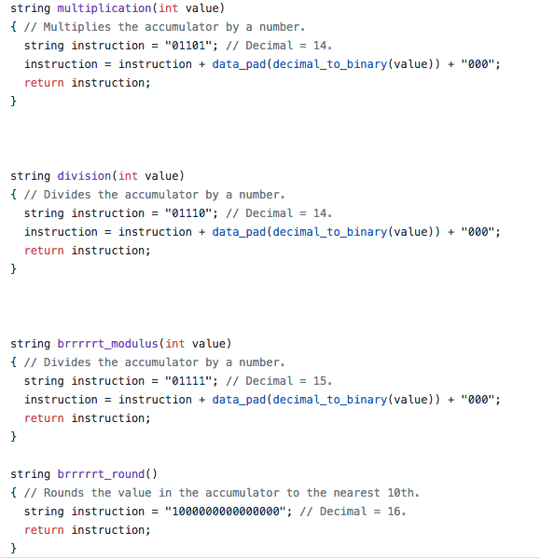

Slide 5
Additional Functions
Subtraction – Takes the number stored in register 0 and subtracts it by a number input by a user. The new number gets stored back into register 0
Addition – Takes the number stored in register 0 and adds it to a number input by a user. The new number gets stored back into register 0
jump – Allows program to utilize looping capabilities
skip – Creates the ability to skip an instruction
Halt – Terminates the instruction calls
clear – Clears register 0 (sets it’s value to 0)

Slide 6
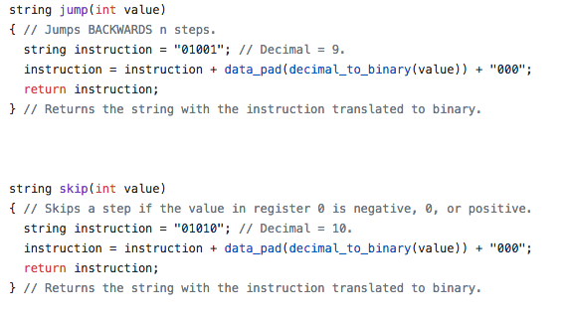
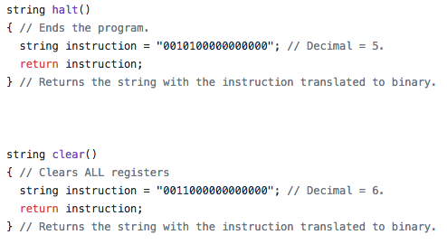

Slide 7
…Additional Functions continued
input – Allows for user input
Output – Gives BRRRRRT the ability to output data and messages
Load – Loads a value from one register into register 0
Load_indirect – Loads a value from a register’s memory address into register 0
Store – Stores the value of register 0 in a different register
Store_indirect – Stores the value of register 0 into the address of a different register. The address that the register holds is restricted to values between 0 and 255

Slide 8
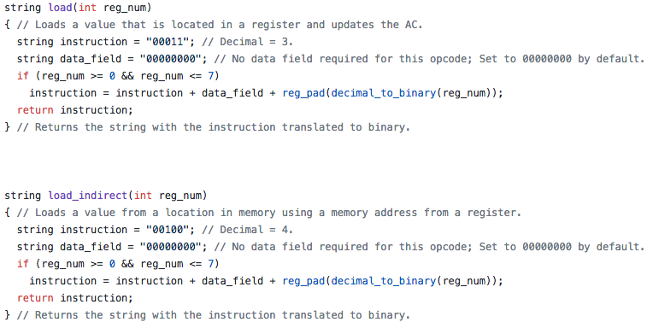
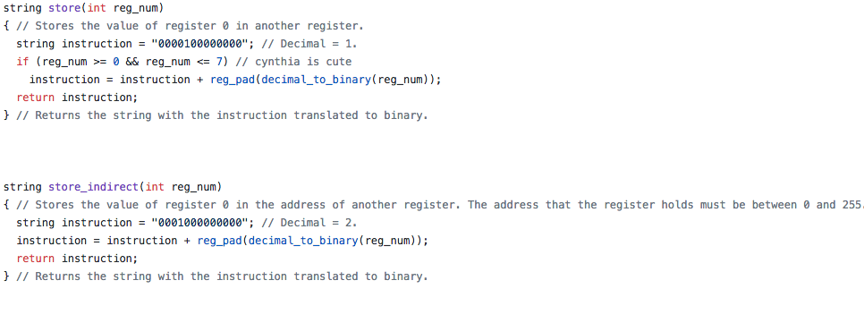

Slide 9
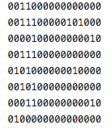
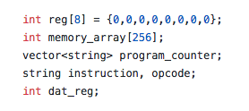
Other Stuff

Slide 10
Complications
Although implementing BRRRRRT had its fair share of smooth sailing, we did have a couple of bumps along the way
We initially decided to create two additional functions which had proven to be too harsh for our time sensitivity
THE CHANGE IN FUNCTIONALITY EFFECTED THE AMOUNT OF BITS NEEDED FOR THE OPCODE

